Slide 1
Host Behavior Analysis

Slide 2
Objective:
The objective of the project is to analyze the Host Behavior patterns in Property Rental Companies.
Specific Objectives include:
Identifying the difference between Super Host and Other Host and determining the factors involved in differentiating them
Analyzing the impact of different metrics on Host performance & Customer satisfaction
Analyzing how online reviews influence the customers to rent certain properties
Examining the co relation between response time & acceptance rate
Role of verified identity and profile picture in contribution to Host’s success rate

Slide 3
Project Explanation:
Project Statement:
Our team (as a group of analysts) has worked on a Property Rental Company (Airbnb) to comprehend how host behaviour varies across a variety of metrics.

Slide 4
Insights:
We started with analyzing the given datasets of different countries and chose to proceed with Dallas-US data.
We analyzed various data points related to Hosts, their guests and their properties to identify the trends and patterns involved.
The overall analysis revolves around response time, acceptance rate, verified identity and online reviews/scores, valid profile picture and bookings based on the property size.
Including the above pointers during our analysis we came across the determining factors which differentiates the Super Hosts from the other Hosts.

Slide 5
Methodology:
We did Data Cleaning of Dallas-US dataset
Imported the datasets of –
- df_dallas_availability,
host_dallas_df,
listing_dallas_df,
review_dallas_df into MySQL Workbench
3. Started analyzing the metrics needed to address the questions given
4. This analysis will help the company to develop strategies for improving the performances of the underperforming Hosts.

Slide 6
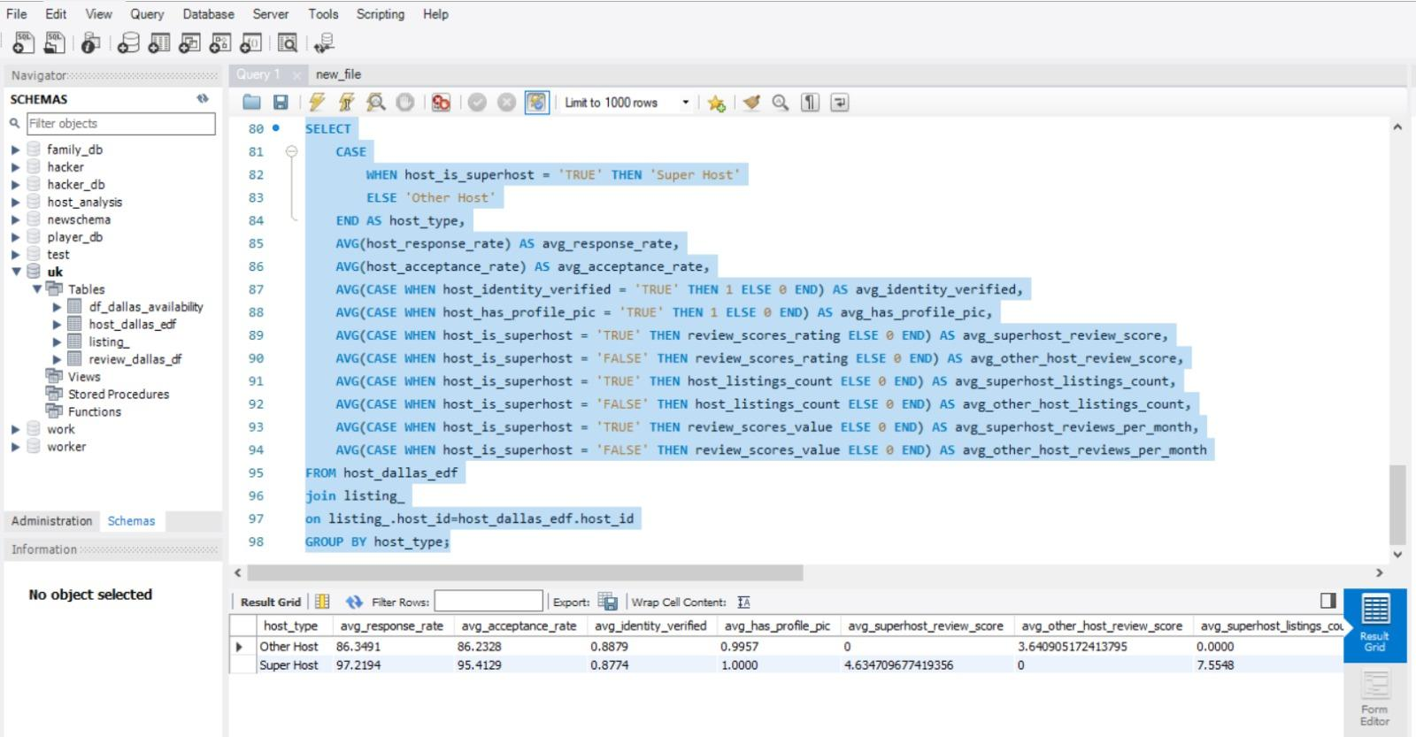
Project Analysis in Detail
Question-1
Analyze different metrics to draw the distinction between Super Host and Other Hosts

Slide 7
Our findings:

Slide 8
Question-2
Based on the above analysis done in question 1, We have Identified the top 3 crucial metrics that one needs to maintain to become a Super Host, they are:
Response rate: Super Hosts have an average response rate of 97%, while other hosts have an average response rate of 86%
Acceptance rate: Super Hosts have an average acceptance rate of 95%, while other hosts have an average acceptance rate of 86%
Review scores: Super Hosts have an average review score of 4.6, while other hosts have an average review score of 3.7.

Slide 9
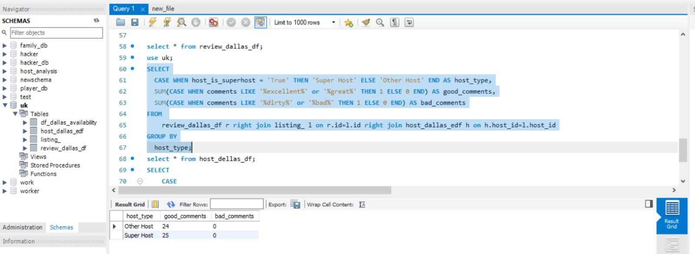
Question-3 Analyze how the comments of reviewers vary for listings of Super Hosts vs Other Hosts(Extract words from the comments provided by the reviewers.)

Slide 10
Our findings:

Slide 11
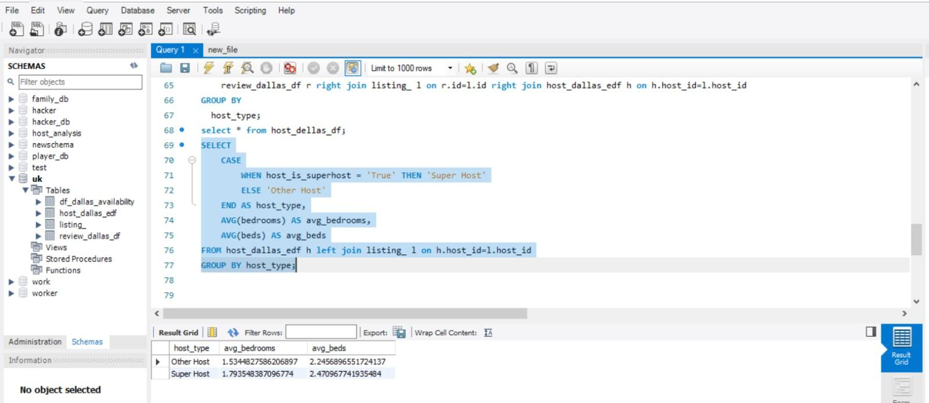
Question-4 Analyze do Super Hosts tend to have large property types as compared to Other Hosts

Slide 12
Our findings:

Slide 13
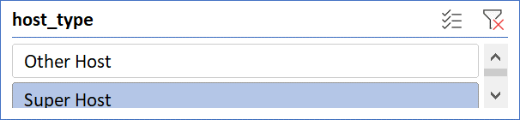
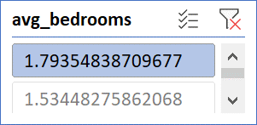
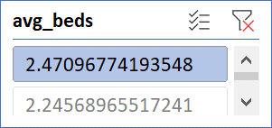
Host Behavior Analysis

Slide 14
Challenges & Problems
Data Quality- at some points, the metrics we analyzed for Super Hosts were proved to be biased. Especially for response rate & acceptance rate.
Importing and Analysis on SQL- since the analysis was done on MySQL WorkBench, importing the data was quite a task. At first we faced difficulty to import the data and once it was done the data cleaning part became equally challenging.
Calculating the Property Size- there were not enough metrics to calculate the exact property size through which we could draw the difference between the properties belonging to Other Hosts & Super Hosts.
Filtering Keywords for Reviews- since we had to analyze the online reviews in bulk we had to build a logic surrounding keywords to study the reviews and their role in bookings. It was a challenge to spot the exact keywords and get the correct analysis based on them.

Slide 15
Future Scope
Master the Art of becoming Super Host- The analysis states how a host can get upgraded to a super host if certain parameters are followed while taking booking orders and maintaining an authentic profile.
Building Trust & Transparency- Clearly, the customers/guests who book the property online need to build a sense of trust and achieve a clear picture of what they are opting for.
Credibility & Customer Satisfaction is must- The analysis would also help the company to achieve credibility and higher customer satisfaction.
User Experience is the Key- Based on the analysis, the company can consider areas of improvement in terms of user’s experience over the platform.

Slide 16
Thank You.

